Slide 1
PantriHub
Shared Inventory Platform for Food Banks
Project Scrum / Progress Check-in
March 18, 2026 | ENSE 281
Shivam Soni • Ethan Behl • Thomas Needham • Ishan Patel • Bushra Alkhateeb

Slide 2

Meet the Team
Shivam Soni
Ethan Behl
Bushra Alkhateeb
Thomas Needham
Ishan Patel

Slide 3
Agenda
01
Project Overview & Problem Statement
02
Current Sprint Status (Yellow)
03
What We Accomplished This Week
04
Technical Architecture & Demo
05
Next Week’s Plan & Recovery Strategy
06
Self-Reflection

Slide 4
The Problem
Food banks in Saskatchewan operate in isolation
PantriHub Solution
No visibility into each other’s inventory
Surplus at one location, shortages at another
Food waste from uncoordinated expiry tracking
Manual processes prone to error
A shared dashboard that lets food banks see, search, and coordinate inventory across all locations in real time.
Validated through interviews with food banks in Regina, Calgary, and Vancouver

Slide 5


Sprint Status
YELLOW
Why Yellow?
Recovery Plan
Team lead (Shivam) unavailable this week
All members had final round of midterms
Sprint 1 (Mar 10–16) behind schedule
Team sync to assign clear ownership
Compress Sprint 1 + overlap with Sprint 2
Regular check-ins to catch blockers early
Sprint 1: Auth + CRUD (FR-01–FR-07)
Sprint 2: Dashboard + Search (FR-08–FR-14)
Mar 10–23 (extended)
Mar 17–23 (overlapping)

Slide 6




This Week’s Progress
Ishan & Bushra
Ethan
Frontend
Backend
Sign Up & Registration page
(FR-01, FR-02)
HTML/Bootstrap layouts
MongoDB database setup
Connection configuration
Thomas
Shivam
Backend
Team Lead / Flex
Helping Ethan setting up the environment
Unavailable last week
Resuming this week
Project scaffolding complete: Node.js/Express initialized with MVC folder structure

Slide 7
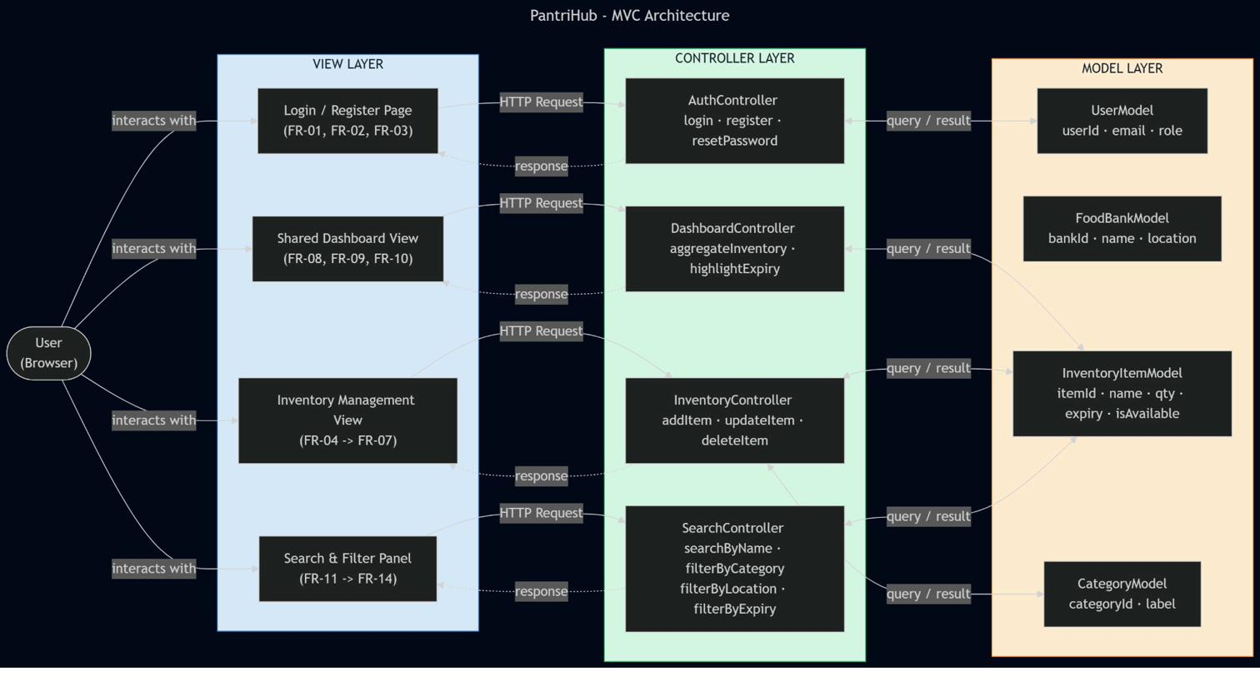
MVC Architecture
Node.js / Express • MongoDB • HTML / CSS / Bootstrap • JavaScript • GitHub

Slide 8

Work-in-Progress Demo
Project Structure
Complete
MVC folder organization (models/, views/, controllers/, routes/)
Sign Up / Registration Page
In Progress
Frontend form with Bootstrap styling (FR-01, FR-02)
Database Schema
In Progress
MongoDB connection setup and initial schema design
GitHub Repository
Active
Version control, Kanban board, and documentation
[LIVE DEMO HERE]

Slide 9
Next Week’s Plan
1
Team Sync Meeting
All
Clearly assign task ownership, eliminate confusion
2
Auth Backend (FR-01–FR-03)
Ethan + Thomas
Login, registration, session management
3
Inventory CRUD (FR-04–FR-07)
Ishan + Bushra
Add, update, delete, mark availability
4
Shared Dashboard (FR-08–FR-10)
Shivam (flex)
Cross-location inventory view, expiry alerts
5
Regular Check-ins
All
Track progress, catch blockers early

Slide 10
Self-Reflection
How did we feel?
What are we proud of?
Academic conflicts made this week stressful, but seeing the registration page come together was motivating. We wish we had more time to commit to development.
Despite limited availability, Ishan and Bushra delivered frontend work, and Ethan moved the database setup forward. The team kept going without Shivam being present.
What did we learn?
Going forward?
Clear task ownership matters. When the lead is absent and assignments are vague, progress slows. We also learned that academic schedules need to be factored into sprint planning.
We will build in buffer time for academic conflicts, hold structured check-ins, and make sure every task has a single owner before a sprint starts.

Slide 11
Thank You
Questions?
github.com/bshra7/Inventory-Management-System-for-Food-Banks
PantriHub | ENSE 281 | March 2026

